Slide 1
WELCOME!
St. Jude Community Homes – City Park Co-Op
January 14, 2020

Slide 2
AGENDA
Who are we? – Introducing Jim & Matthew
Who & What is St. Jude Community Homes?
Strengths and Needs of City Park Co-Op Residents
Community Partner – Sherbourne Health Centre
How will our programming work?
Open Forum / Q&A
Wrapping Up and Next Steps
*there is a confidential suggestion/comment box that folks can write into if that is helpful! ☺*

Slide 3
Who we are
Jim Nason:
Program Manager at St. Jude Community Homes
Over twenty five years social work experience in mental health, addictions, HIV/AIDs and community-based work
Writer and teacher
Matthew Conroy:
Program Resource Worker at St. Jude Community Homes since 2018
Graduated from Fleming College (Peterborough) with diplomas in Mental Health & Addictions and Social Service Worker
Bachelor of Social Work student at Ryerson University
Previous work experience includes working in the Older Adult, Trans and food drop-in programs at The 519

Slide 4
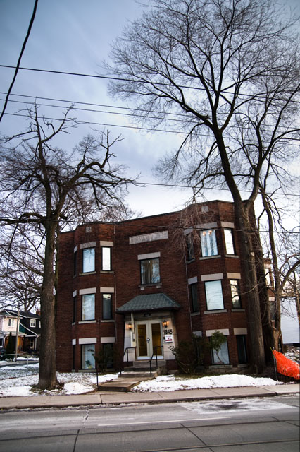
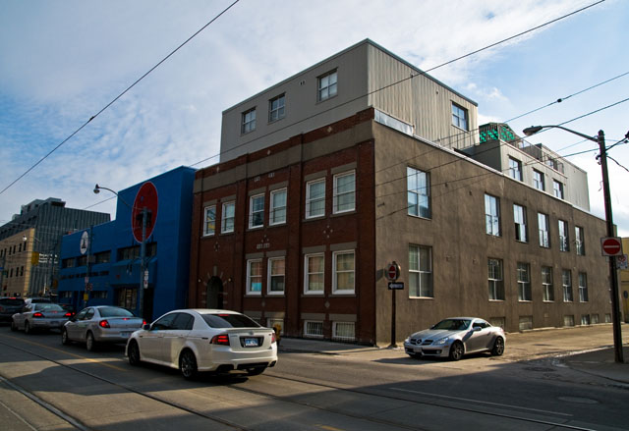
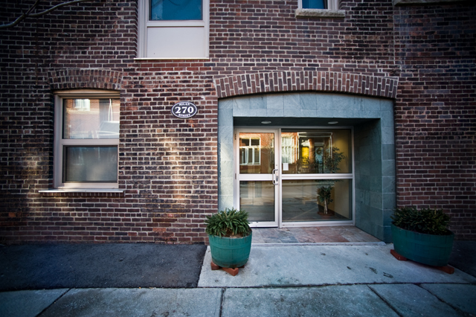
St. jude community homes
St. Jude Community Homes is a private non-profit organization that provides permanent, safe, affordable housing and a place to call home.
Supportive housing and community outreach, collaboration and partnerships with the supportive housing network and various other outreach/support services
Have an in depth understanding of community resources- continuing to work on a resource collection for Church/Wellesley area

Slide 5
City Park Strengths
Here’s What we’ve Seen and Heard:
Strong sense of community
Inclusive of newcomers and diverse communities
Beautiful gardens
Dedicated staff and Board with a commitment to keeping you safe and the buildings in good shape
Terrific downtown location near many community resources (519, Progress Place, Loblaws, hospitals, health centres, universities, and colleges…)
Wonderful neighbours who you can depend on.

Slide 6
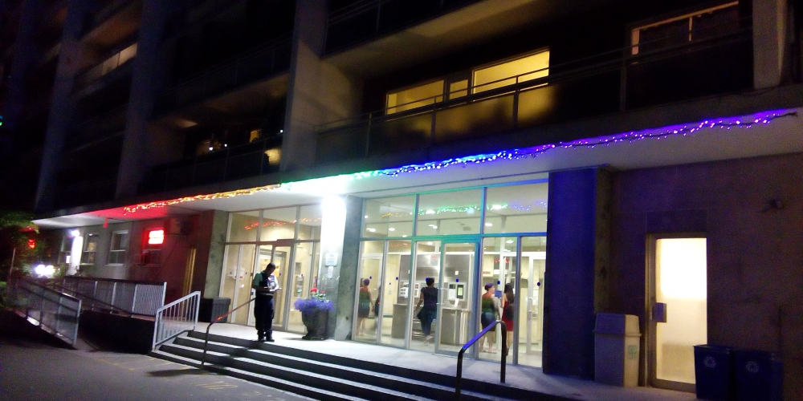
UNDERSTANDING THE NEEDS WITHIN CITY PARK CO-OP
Hoarding
Counselling
Loneliness
Addiction
Aging
Race
Sexuality
Suicide Prevention
Money and Rent challenges
Quality of Living
Pest Control
Gardening

Slide 7
Role of city park staff
City Park team will speak to this and the Needs Assessment.

Slide 8
Community partnership – sherbourne health
WELCOME TO SHERBOURNE HEALTH
Like the unique mosaic at our front door, Sherbourne was shaped by our communities. Our primary care and chronic disease management services, health promotion and education, outreach and social supports, and mental health services work together to provide transformative care and support.
While Sherbourne is open to everyone in our neighbourhood, we are particularly committed to helping people who may have been under-served by conventional health care.
SERVices:
Homeless and Under-Housed People
Lesbian, Gay, Bisexual, Trans and Queer (LGBTQ) People
Newcomers to Canada
Mid-East Toronto Neighbourhood
Health Bus
Counselling (stress management and other mental health challenges)

Slide 9
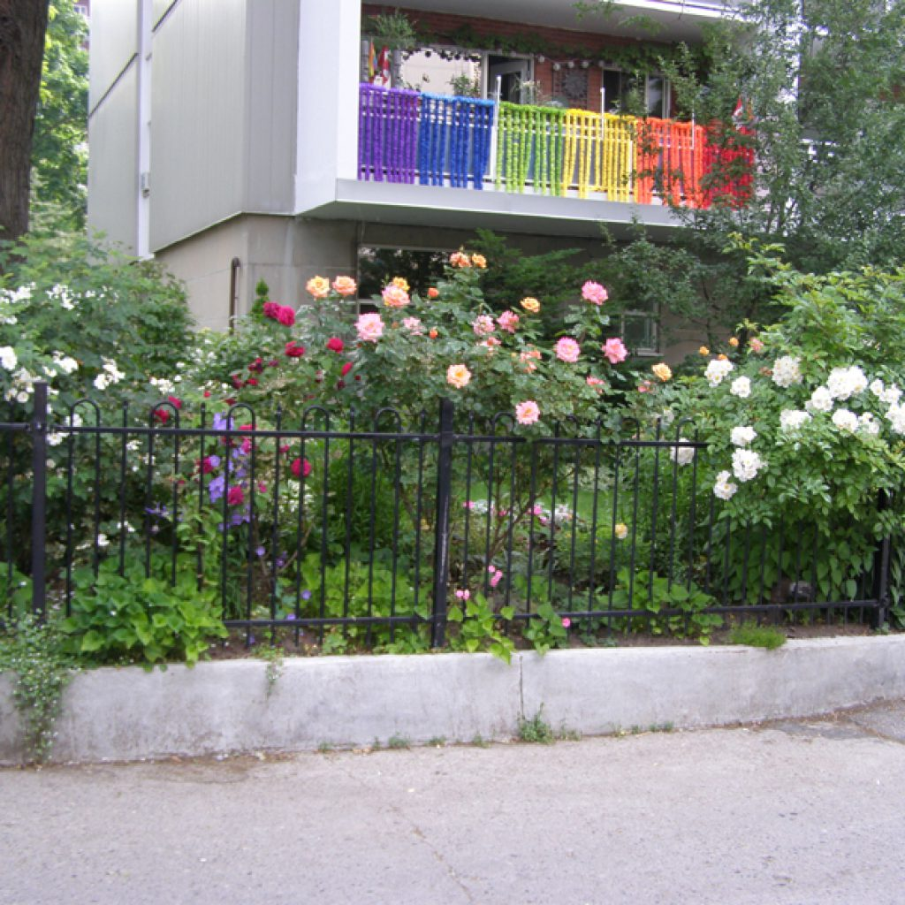
Our program
Our Program Offers:
Housing Issues & Support
2SLGBTQ+ Support
Mental Health & Addictions Support and Referrals
Health Care Resources and Referrals
Personal issues, counselling and goal setting
Workshops and community activities

Slide 10
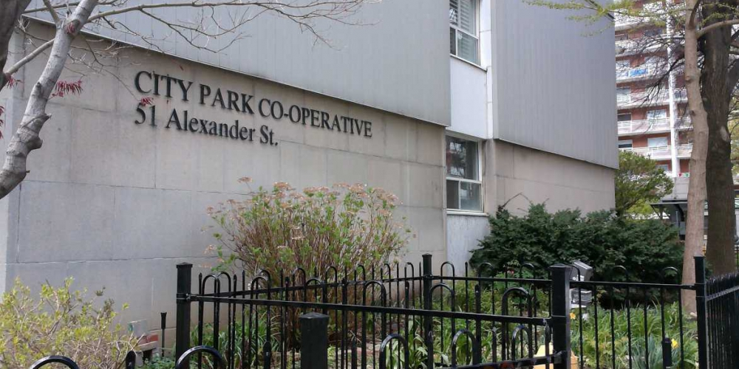
Our program
Programming is currently focused on the 484 Church building, other buildings will be on an as-needed basis while we launch the program
Program Office will be in 51 Alexander Street
Program Hours:
Tuesday and Thursday – 11am to 5pm
Friday – 1pm to 6pm

Slide 11
Open forum & discussion
Some prompts:
What does home mean to you?
What does being part of a co-op mean to you?
What are some things that are successful at City Park?
What are some things that could be improved?
Is there anything else you would like to see from us and our programming?

Slide 12
Wrap-up and next steps
Matthew will be your contact person for SJCH
Jim will be working with Matt, SJCH E. D. (Carol Zoulalian),Board Members, and Sherbourne Health.
He will connect about the service with Matt and Santosh on a weekly basis
Matt’s on-site hours: Tuesdays and Thursdays 11-5 and Friday 1-6
Programming begins on February 4
With your permission, City Park can make referrals to us. If you have been referred to us by City Park, we will reach out to you once programming begins
If you have not been referred and would like our support, please contact us via telephone, email or drop by during programming hours
This Program is funded until September. In late spring we will have another meeting like this to see how things are going and what needs to be fine-tuned so that we can continue our work here with you.

Slide 13
CONTACT INFO
Matthew Conroy – Program Resource Worker MConroy@sjch.ca (416) 924-6294 ext. 112
Jim Nason – Program Manager JNason@sjch.ca (416) 703-7222 ext. 322

